Slide 2
2.

Slide 4
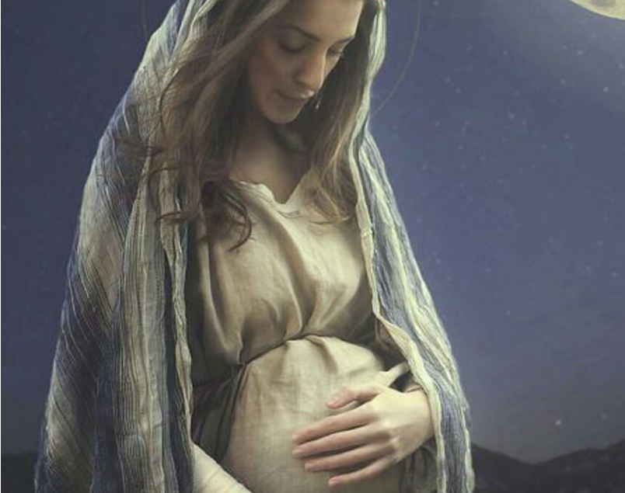
Now the birth of Jesus Christ was as follows: After His mother Mary was betrothed to Joseph, before they came together, she was found with child of the Holy Spirit. Then Joseph her husband, being a just man, and not wanting to make her a public example, was minded to put her away secretly. But while he thought about these things, behold, an angel of the Lord appeared to him in a dream, saying, Joseph, son of David, do not be afraid to take to you Mary your wife, for that which is conceived in her is of the Holy Spirit.
Matthew 1:18-20

Slide 5
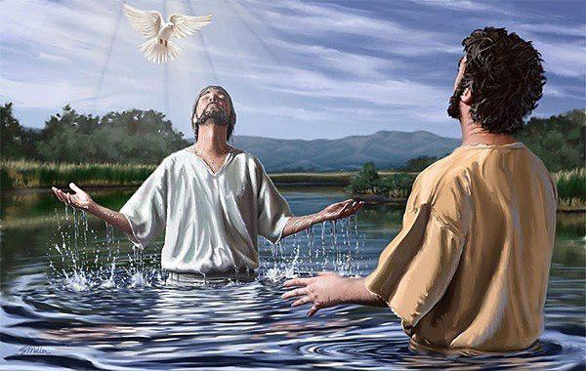
When He had been baptized, Jesus came up immediately from the water; and behold, the heavens were opened to Him, and He saw the Spirit of God descending like a dove and alighting upon Him. And suddenly a voice came from heaven, saying, this is My beloved Son, in whom I am well pleased.
Matthew 3:16-17

Slide 6
Mark 2:10-11, (Innate POWER)
Mark 1:23-25, POWER over demons
Matt 8:2-3, POWER to heal leprosy
John 10:17-18, POWER over death
POWER TO FORGIVE SINS
Mark 2:5, Paralyzed man
Luke 7:48, Sinful woman
John 8:11, Adulterous woman
Luke 23:43, Penitent thief

Slide 7
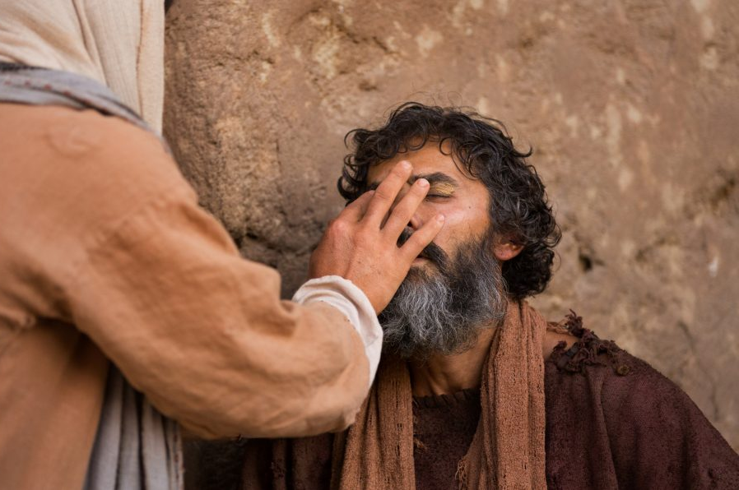
Public “Anointing” pronouncement: Sonship & Messiahship of Jesus.
Jesus had inherent power to work miracles as God With Us.
…how God anointed Jesus of Nazareth with the Holy Spirit AND with power, who went about doing good and healing all who were oppressed by the devil, for God was with Him. (Acts 10:38)

Slide 9
To the apostles, Jesus said: Behold, I send the Promise of My Father upon you; but tarry in the city of Jerusalem until you are endued with power from on high, (Lk 24:49).
A Special promise made to the Apostles, fulfilled in Jerusalem.
And being assembled together with them (apostles, vs 2), He commanded them not to depart from Jerusalem, but to wait for the Promise of the Father, which, He said, you have heard from Me; for John truly baptized with water, but you shall be baptized with the Holy Spirit not many days from now, (Acts 1:4-5)
Joel 2:28, And it shall come to pass afterward that I will pour out My Spirit on all flesh…

Slide 10
When the Day of Pentecost had fully come, they (apostles, 1:26) were all with one accord in one place. And suddenly there came a sound from heaven, as of a rushing mighty wind, and it filled the whole house where they were sitting. Then there appeared to them divided tongues, as of fire, and one sat upon each of them. And they were all filled with the Holy Spirit and began to speak with other tongues, as the Spirit gave them utterance, (Acts 2:1-4).
A Special promise made to the Apostles, fulfilled in Jerusalem.
The promise is Realized in Acts 2.
But this is what was spoken by the prophet Joel: And it shall come to pass in the last days, says God, that I will pour out of My Spirit on all flesh…
Acts 2:15-16

Slide 11
If you love Me, keep My commandments. And I will pray the Father, and He will give you another Helper, that He may abide with you forever—the Spirit of truth, whom the world cannot receive, because it neither sees Him nor knows Him; but you know Him, for He dwells with you and will be in you.
John 14:15-17
A Special promise made to the Apostles, fulfilled in Jerusalem.
The promise is Realized in Acts 2.
A Special Purpose for the apostles of Jesus.
Another Helper after Jesus ascended.
With INSPIRATION,
Acts 2:4; 1 Cor 2:12-13
With POWER,
Acts 1:8; Acts 4:33

Slide 12
The Holy Spirit would continue to counsel (advise) the chosen apostles by revealing God’s divine truth; the Holy Spirit, therefore, is called “Spirit of Truth.”
Reveal to those apostles all truth, Jn 16:13.
Teach those apostles all things, Jn 14:26.
Reveal previously unrevealed truths to the apostles, Jn 16:13.
Provide the apostles with perfect remembrance, Jn 14:26.
Bear witness of Christ, of Christ with the apostles Jn 15:26-27, Ac 1:22.
Provide the apostles with the power to impart spiritual gifts, Acts 8:18; Acts 19:6.

