Slide 2
3.

Slide 3
While Peter was still speaking these words, the Holy Spirit fell upon all those who heard the word.
Acts 10:44
UNDERSTAND:
This did not save them (Ac 10:47-48).
This was not the gift of (Ac 2:38).
This did not guide them into all truth.

Slide 4
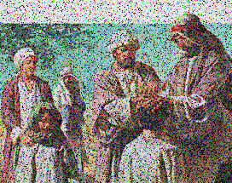
There are diversities of gifts, but the same Spirit. There are differences of ministries, but the same Lord. And there are diversities of activities, but it is the same God who works all in all. But the manifestation of the Spirit is given to each one for the profit of all:
1 Cor 12:4-7
1 Corinthians 12
Word of Wisdom (v8)
Word of Knowledge (v8)
Faith (v9)
Healings (v9)
Working of Miracles (v10)
Prophecy (v10)
Discerning of spirts (v10)
Tongues (v10)
Interpretation of Tongues (v10)

Slide 5
Is NOT Miraculous Spiritual Gifts.
Is NOT the Indwelling of the Holy Spirit.
Is NOT the Fruit of the Spirit.
Then Peter said to them, “Repent, and let every one of you be baptized in the name of Jesus Christ for the remission of sins; and you shall receive the gift of the Holy Spirit. For the promise is to you and to your children, and to all who are afar off, as many as the Lord our God will call.
Acts 2:38-39

Slide 6
Then Peter said to them, “Repent, and let every one of you be baptized in the name of Jesus Christ for the remission of sins; and you shall receive the gift of the Holy Spirit. For the promise is to you and to your children, and to all who are afar off, as many as the Lord our God will call.
Acts 2:38-39

Slide 7
Jn 4:10, the gift of God
Living water / vss 10, 14
Rom 6:23, the gift of God
Eternal life / vs 23
Eph 4:7, the gift of Christ
Grace / vs 7
Acts 2:38, the gift of the Holy Spirit
The Promise / vs 39

