Slide 2
5.

Slide 3
All the inhabitants of the earth are reputed as nothing; He does according to His will in the army of heaven and among the inhabitants of the earth. No one can restrain His hand or say to Him, what have You done? (Dan 4:35)
For by Him all things were created that are in heaven and that are on earth, visible and invisible, whether thrones or dominions or principalities or powers. All things were created through Him and for Him. And He is before all things, and in Him all things consist. (Col 1:16-17)
Oh, the depth of the riches both of the wisdom and knowledge of God! How unsearchable are His judgments and His ways past finding out! For who has known the mind of the Lord? Or who has become His counselor? (Rom 11:33-34)

Slide 4
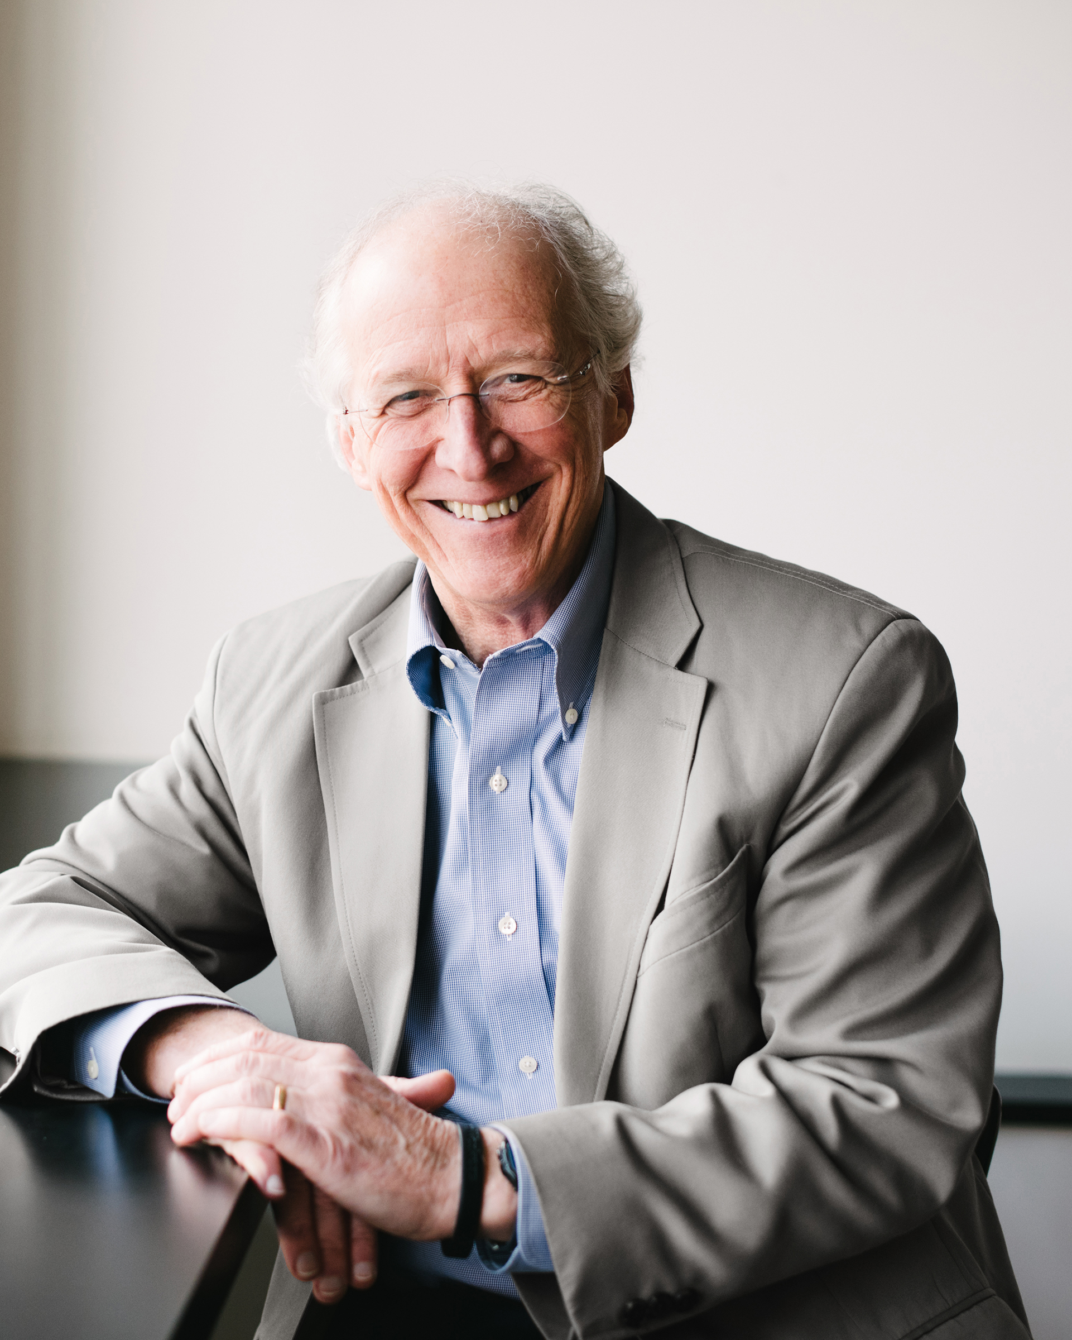
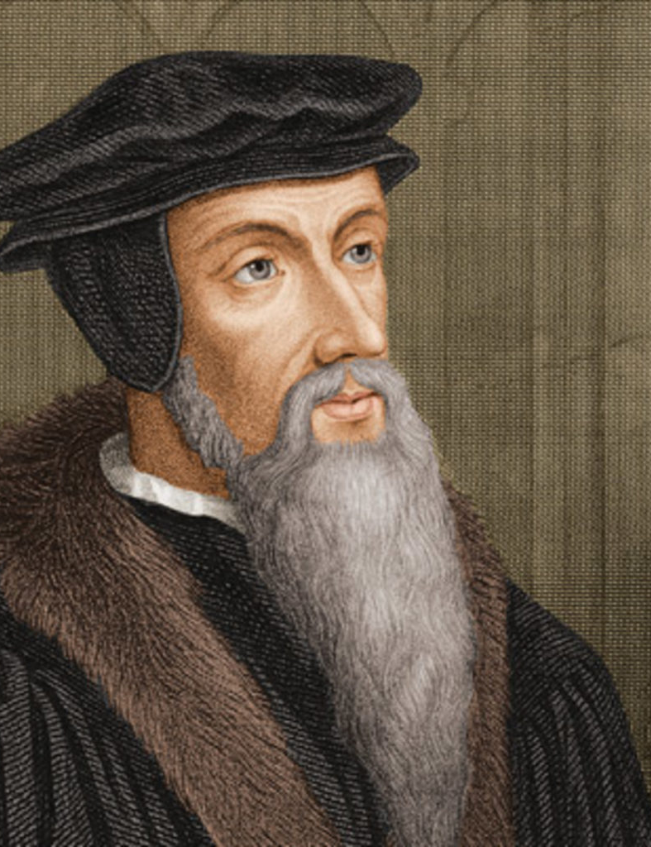
John Calvin
John Piper
“…the (Holy) Spirit (is) the inner teacher by whose effort the promise of salvation penetrates into our minds, a promise that would otherwise only strike the air or beat upon our ears.”
John Calvin taught that God “elects” some people from eternity past to be saved while damning all others to eternal hell with no hope of being saved.
“God sends the Holy Spirit as a preserving seal to lock in our faith, as an authenticating seal to validate our sonship” and also as protection “to keep out destructive forces.”

Slide 6
Apostles:
Reveal to the apostles “all things” (Word of God, Jn 14:24, 26).
Give the apostles perfect recall of all Jesus taught (Jn 14:26).
Uncover and make known “all truth” (Jn 16:13; 1 Cor 2:12-13; 2 Pet 1:3; Jude 3).
Miraculously confirm this truth (Mk 16:20; Heb 2:3).
Inspire and preserve the writing (permanent record) of God’s Word (Matt 24:35; 2 Pet 1:20-21; Eph 3:3-4; Rev 2:1, 7).
Began at Pentecost (Jn 14:15-20; Acts 1:8; Acts 2:1-4).
Ended when the complete revelation of God was given (1 Cor 13:8-11).

Slide 7
The work of the Holy Spirit
Is accomplished through the Word of God
CONVERSION
SANCTIFICATION
LEADS
BEARS WITNESS
SEALED BY
COMFORTS

