Slide 1
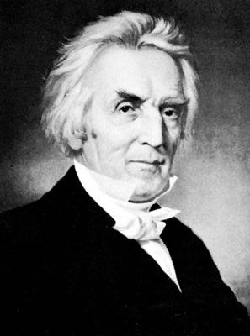
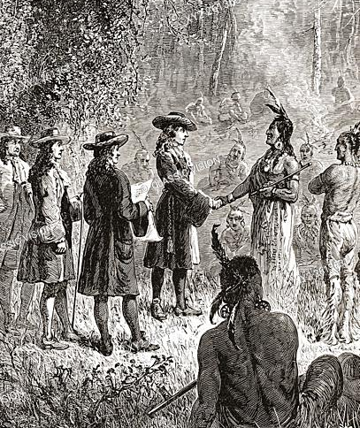
Alexander Campbell
1788-1866
Notable Member of “The Restoration Movement”
Author of the publication “The Millennial Harbinger”
How Indians Read The Bible
Published December 1833

Slide 2
The Truth About baptism
What God’s Word Says

Slide 3
Steps To Salvation:
Hear
Believe
Repent
Confess
Baptism
Faithful Life

Slide 4
Hebrews 4:12
Steps To Salvation:
Hear
Believe
Repent
Confess
Baptism
Faithful Life
For the word of God is living and active and sharper than any two-edged sword, and piercing as far as the division of soul and spirit, of both joints and marrow, and able to judge the thoughts and intentions of the heart.

Slide 5
Hebrews 4:12
Mark 4:24
Steps To Salvation:
Hear
Believe
Repent
Confess
Baptism
Faithful Life
And [ Jesus ] was saying to them, “Take care what you listen to. By your standard of measure it will be measured to you; and more will be given you besides.”

Slide 6
Hebrews 4:12
Mark 4:24
Romans 10:17
Steps To Salvation:
Hear
Believe
Repent
Confess
Baptism
Faithful Life
So faith comes from hearing, and hearing by the word of Christ.

Slide 7
Romans 10:17
Hebrews 11:1,6
Steps To Salvation:
Hear
Believe
Repent
Confess
Baptism
Faithful Life
Now faith is the assurance of things hoped for, the conviction of things not seen.
And without faith it is impossible to please Him, for he who comes to God must believe that He is and that He is a rewarder of those who seek Him.

Slide 8
Romans 10:17
Hebrews 11:1,6
1 Peter 1:6-7
Steps To Salvation:
Hear
Believe
Repent
Confess
Baptism
Faithful Life
'In this you greatly rejoice, even though now for a little while, if necessary, you have been distressed by various trials, so that the proof of your faith, being more precious than gold which is perishable, even though tested by fire, may be found to result in praise and glory and honor at the revelation of Jesus Christ

Slide 9
Luke 5:31-32
Steps To Salvation:
Hear
Believe
Repent
Confess
Baptism
Faithful Life
Jesus answered them, “It is not the healthy who need a doctor, but the sick. I have not come to call the righteous, but sinners to repentance.”

Slide 10
Luke 5:31-32
2 Peter 3:9
Steps To Salvation:
Hear
Believe
Repent
Confess
Baptism
Faithful Life
The Lord is not slow to fulfill his promise as some count slowness, but is patient toward you, not wishing that any should perish, but that all should reach repentance.

Slide 11
Luke 5:31-32
2 Peter 3:9
2 Corinthians 7:9-10
Steps To Salvation:
Hear
Believe
Repent
Confess
Baptism
Faithful Life
I now rejoice, not that you were made sorrowful, but that you were made sorrowful to the point of repentance; for you were made sorrowful according to the will of God, so that you might not suffer loss in anything through us. For the sorrow that is according to the will of God produces a repentance without regret, leading to salvation, but the sorrow of the world produces death.

Slide 12
1 John 4:15
Steps To Salvation:
Hear
Believe
Repent
Confess
Baptism
Faithful Life
Whoever confesses that Jesus is the Son of God, God abides in him, and he in God.

Slide 13
1 John 4:15
Matthew 10:32-33
Steps To Salvation:
Hear
Believe
Repent
Confess
Baptism
Faithful Life
Therefore everyone who confesses Me before men, I will also confess him before My Father who is in heaven. But whoever denies Me before men, I will also deny him before My Father who is in heaven.

Slide 14
1 John 4:15
Matthew 10:32-33
Romans 10:6,9-10
Steps To Salvation:
Hear
Believe
Repent
Confess
Baptism
Faithful Life
But the righteousness based on faith speaks as follows…that if you confess with your mouth Jesus as Lord, and believe in your heart that God raised Him from the dead, you will be saved; for with the heart a person believes, resulting in righteousness, and with the mouth he confesses, resulting in salvation.

Slide 15
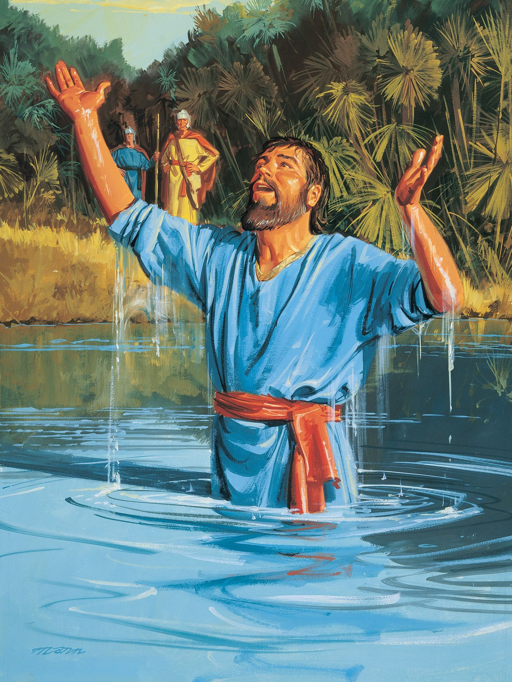
Steps To Salvation:
Naaman & Prophet Elisha
2 Kings 5
Naaman hears of Elisha.
Naaman believes Elisha can heal his leprosy.
Naaman is reluctant to obey as first, but is eventually fully obedient.

Slide 16
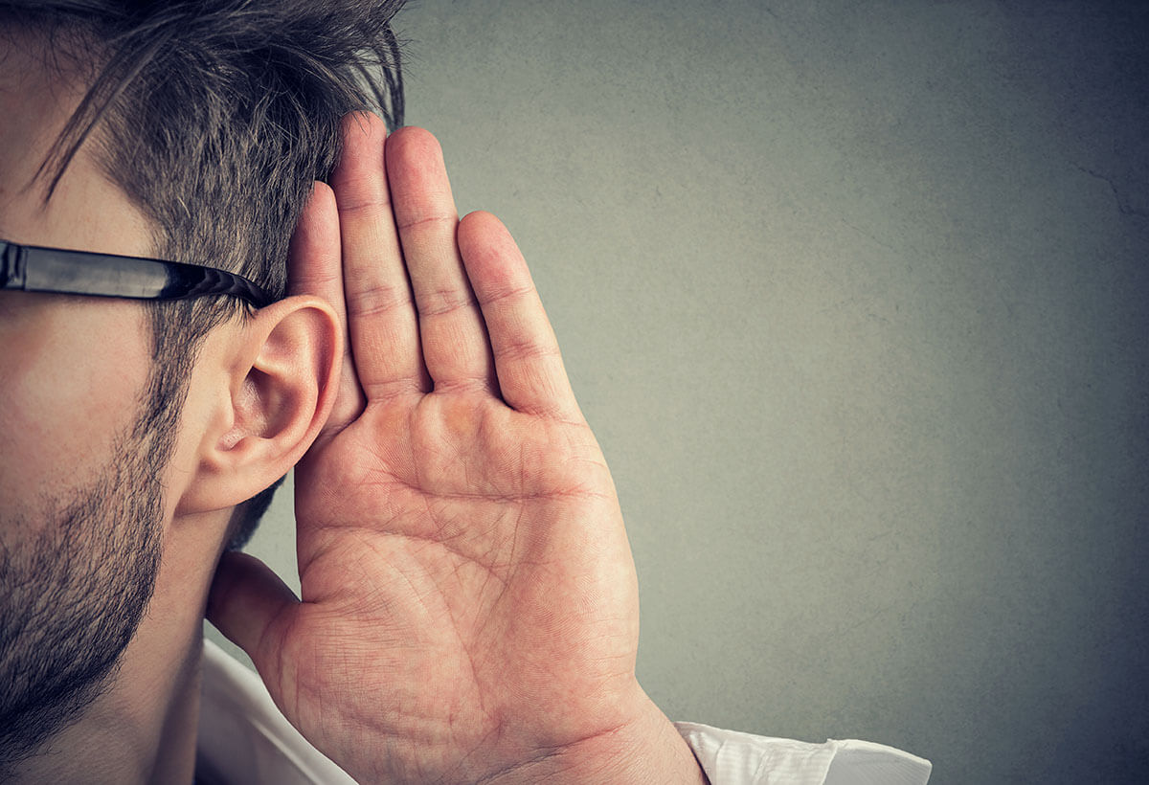
Steps To Salvation:
Don’t Hear, or
Don’t Believe, or
Motivation to Full Obedience
Hear
Believe

Slide 17
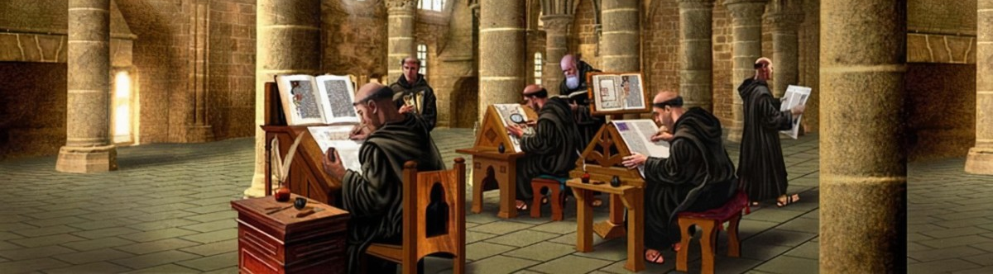
The Word “Baptism”
Steps To Salvation:
Hear
Believe
Repent
Confess
Baptism
Faithful Life
Greek βαπτίζω “baptízō” (G9078)
“Baptism” transliterated from “Baptizo”
to dip repeatedly, to immerse, to submerge (of vessels sunk)
to cleanse by dipping or submerging, to wash, to make clean with water, to wash one's self, bathe

Slide 18
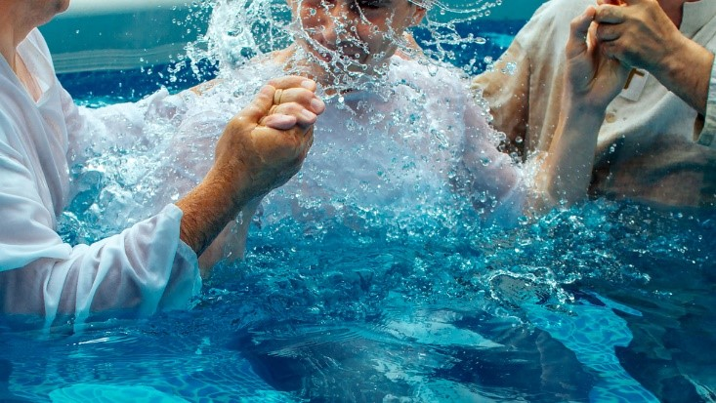
What Baptism Is:
Romans 6:3-11
Steps To Salvation:
Hear
Believe
Repent
Confess
Baptism
Faithful Life
Symbolic of Christ’s death, burial, and resurrection

Slide 19
What Baptism Is:
Romans 6:3-11
1 Peter 3:21
Steps To Salvation:
Hear
Believe
Repent
Confess
Baptism
Faithful Life
Symbolic of Christ’s death, burial, and resurrection
An act of salvation
An appeal to God for a conscience clean of sin

Slide 20
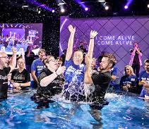
What Baptism Is Not:
Steps To Salvation:
Hear
Believe
Repent
Confess
Baptism
Faithful Life
Incorrect Methods
Incorrect Reasons
Incorrect Responses

Slide 21
Steps To Salvation:
Hear
Believe
Repent
Confess
Baptism
Faithful Life
Day of Pentecost (Acts 2)
Belief of a Heard Gospel (one sermon)
Call to Actions:
Repentance
Baptism
Generational Faithful Living
Not present in story:
No call to action
Complete understanding of Christian living

Slide 22
Steps To Salvation:
Hear
Believe
Repent
Confess
Baptism
Faithful Life
Ethiopian Eunuch (Acts 8)
Heart open to the gospel
Someone willing to teach
“Preached Jesus” → A realized urgent need for immediate baptism
Phillip convicted him
The Eunuch confessed Christ
“Down into the water” / “Up out of the water”
Rejoicing in salvation!

Slide 23
Steps To Salvation:
Hear
Believe
Repent
Confess
Baptism
Faithful Life
Philippian Jailer (Acts 16)
Effect of Paul & Silas’ example of glorifying God
Heart open to salvation
“Spoke the word of the Lord” → A realized urgent need for immediate baptism
“Rejoiced greatly, having believed in God”

Slide 24
Steps To Salvation:
Hear
Believe
Repent
Confess
Baptism
Faithful Life

Slide 25
Steps To Salvation:
Hear
Believe
Repent
Confess
Baptism
Faithful Life
The Cost of Discipleship
Luke 14:25-33
Counting The Cost: The Builder & The King
What/Who are we willing to give up?
John 15:1-25
Our relationship to others
2 Timothy 2:1-7
“Be strong” / “Suffer hardship”
Soldier / Athlete / Farmer

Slide 26
Steps To Salvation:
Hear
Believe
Repent
Confess
Baptism
Faithful Life
So faith comes from hearing, and hearing by the word of Christ. –Rom. 10:17
not wishing that any should perish, but that all should reach repentance –2 Pet. 3:9
Whoever confesses that Jesus is the Son of God, God abides in him, and he in God. –1 Jn 4:15
Be baptized in the name of Jesus Christ for the forgiveness of your sins –Ax. 2:38
Be faithful until death, and I will give you the crown of life –Revelation 2:10

